Slide 1
PROJECT TITLE : ADVANCE TRAFFIC NAVIGATION SYSTEM
PIP104 University Project-II
Final Review
Batch Number:
Roll Number | Student Name
20201CEI0144 | PAPPU V S S SUBRAHMANYESWARA REDDY
20201CEI0097 | NAGIREDDY Gari JASWANTH KUMAR REDDY
20201CEI0124 | MITTAPALLI SIVA SAI SANTHOSH
Under the Supervision of,
Ms. SHILPA C N
Assistant Professor Grade-1
School of Computer Science & Engineering
Presidency University

Slide 2
Introduction
In the realm of modern transportation infrastructure, the maintenance of roads is a critical factor that directly influences both the safety of commuters and the overall economic well-being of a nation.
Potholes and humps on roadways pose significant challenges, leading to potential accidents, vehicle damages, and hindrances to smooth traffic flow.
Addressing this issue head-on, our project introduces an advanced system for the timely detection and notification of road anomalies, specifically focusing on potholes and humps.
Our innovative solution employs cutting-edge technology to provide a comprehensive approach to road maintenance. By utilizing ultrasonic sensors, we can accurately identify potholes and measure their depth, offering crucial data for efficient maintenance strategies.

Slide 3
Introduction
Simultaneously, our system incorporates RF transmitters strategically placed on road humps, communicating seamlessly with RF receivers within vehicles. As a vehicle approaches a hump, the system triggers instant notifications, alerting drivers through audible signals and visual warnings on an LCD display..
advanced potholes and humps notification system apart is its commitment to cost-effectiveness without compromising on efficiency. The integration of low-cost ultrasonic sensors ensures a practical and scalable solution that can be readily implemented in various settings.
In this era of interconnected smart technologies, our project aligns with the transformative potential of IoT, contributing to a safer and more efficient road network.
Furthermore, our system leverages the power of the Internet of Things (IoT) by transmitting real-time data to the cloud via WIFI, accessible to drivers through a dedicated mobile application..

Slide 4
Literature Review
He Youquan, Wang Jian, QiuHanxing, Zhang Wei, XieJianfang, “A Research of Pavement Potholes Detection Based on Three-Dimensional Project Transformation”, In Proceedings of International Congress on Image and Signal Processing, pp.1805-1808, 2011.**
MirceaStrutu, GrigoreStamatescu, Dan Popescu, “A Mobile Sensor Network Based Road Surface Monitoring System”, In Proceedings of IEEE Conference on System Theory, Control and Computing, pp.630–634, 2013.
Moazzam, K. Kamal, S. Mathavan, S. Usman, M. Rahman, “Metrology and Visualization of Potholes using the Microsoft Kinect Sensor”, In Proceedings of IEEE Conference on Intelligent Transport System, pp.1284-1291, 2013
powerful simulation tools (Gupta et al., 2020), allowing researchers to study the impact of different navigation strategies on traffic flow.

Slide 5
Literature Review
The foundation of advanced traffic navigation systems lies in the broader context of Intelligent Transportation Systems (ITS).
Researchers (Smith et al., 2017) define ITS as an integrated framework that employs various technologies, including GPS, RFID, communication protocols, sensors, and data analytics, to enable efficient transportation.
This framework serves as the backbone for the development of advanced navigation solutions.
The advent of vehicle-to-infrastructure communication is transforming traditional navigation systems. Dedicated Short Range Communication (DSRC) and Cellular Vehicle-to-Everything (C-V2X).

Slide 6
Research Gaps Identified
Accuracy Improvement :
Many current systems may lack precision in identifying potholes and humps, leading to false positives or negatives. Enhancing the accuracy of detection is a critical research area.
Real-time Data Processing :
Some methods might face challenges in processing data in real-time, impacting the timely notification of road hazards to drivers. Exploring efficient real-time processing techniques is essential.
Adaptability to Road Conditions:
Current systems may struggle to adapt to diverse road conditions, weather, and lighting variations. Research should focus on developing robust algorithms that perform well under different circumstances.

Slide 7
Research Gaps Identified
Cost-effective Sensor Integration:
Investigating cost-effective sensor solutions that can be easily integrated into existing road infrastructure is crucial for widespread implementation and scalability.
User-Friendly Notifications:
Understanding the optimal ways to notify drivers about road hazards without causing distraction or confusion is vital for user acceptance and safety.
Integration with Autonomous Vehicles:
Future research should explore the seamless integration of pothole and hump detection systems with autonomous vehicles to enhance road safety and navigation.

Slide 8
Research Gaps Identified
Network Security and Reliability:
Ensuring the security and reliability of the communication network between the road infrastructure, sensors, and drivers is essential to prevent malicious interference and ensure system dependability.
Long-Term System Maintenance:
Research could focus on developing systems that require minimal maintenance over extended periods to ensure sustainability and avoid frequent disruptions.
Addressing these research gaps would contribute to the development of more effective and reliable Automatic Detection and Notification systems for road hazards.

Slide 9
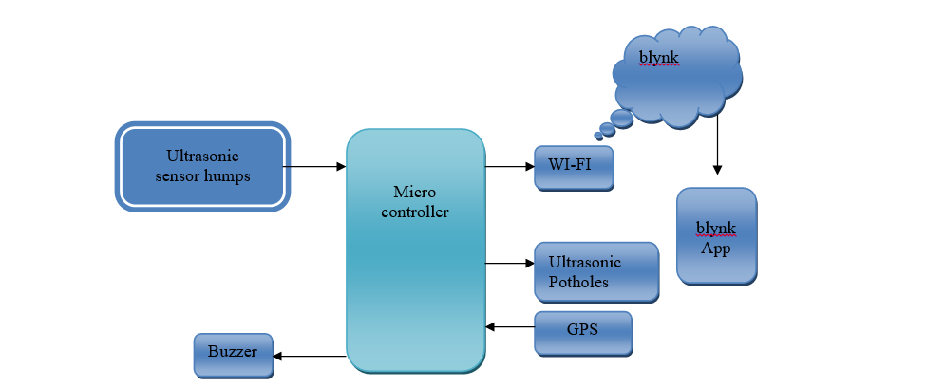
Methodology

Slide 10
Methodology
Components Used:
Hardware Requirements:
Microcontroller
Ultrasonic sensors
Buzzer
Ultrasonic sensor for potholes
Ultrasonic sensor for humps
WIFI
Android Smart phone

Slide 11
Proposed Method
The proposed system uses four sensors which are pH, turbidity, ultrasonic, DHT-11, microcontroller unit as the main processing module and one data transmission module ESP32 Wi-Fi module (NodeMCU).
The microcontroller unit is a significant part of the system developed for Patholes because The Arduino Mega consumes low power, and it is a small size, where the size is a good use for finding Patholes on Roads.
Among two sensors, two of the sensors collect the data in the form of analog signals; the GPS has an on-chip that Locates the where the patholes and humps are present.

Slide 12
Proposed Method
Select Sensors: Choose IoT Hardware: Select suitable sensor like Hump Detector and IoT hardware, such as microcontrollers (e.g., Arduino or Raspberry Pi) and connectivity modules (Wi-Fi, Bluetooth, etc.).
Data Acquisition: Connect the sensors to the IoT hardware to collect data. You may need analog-to-digital converters for some sensors.
Data Transmission: Send the collected data to a central server or cloud platform using MQTT, HTTP, or other suitable protocols.
Cloud Platform: Utilize a cloud platform (e.g., AWS IoT, Azure IoT, or Google Cloud IoT) to manage and store data. Set up a database to store water quality information.

Slide 13
Objectives
To review literature on the sensors used for detecting the potholes and humps.
To review literature on microcontrollers used in the existing methods.
To learn about the Blynk app interfacing, how to use it for accessing information.
To learn about the Arduino board and Atmega328 microcontroller.

Slide 14
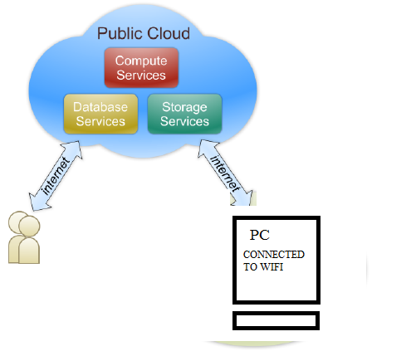
ARCHITECTURE OF CLOUD

Slide 15
ARCHITECTURE OF CLOUD
The Internet of Things (IoT), also sometimes referred to as the Internet of Everything (IoE), consists of all the web-enabled devices that collect, send and act on data they acquire from their surrounding environments using embedded sensors, processors and communication hardware.
These devices, often called "connected" or "smart" devices, can sometimes talk to other related devices, a process called machine-to-machine (M2M) communication, and act on the information they get from one another. Humans can interact with the gadgets to set them up, give them instructions or access the data, but the devices do most of the work on their own without human intervention.

Slide 16
System Design
Sensor Module:
Camera: Install high-resolution cameras on vehicles or roadside infrastructure. These cameras capture images or videos of the road surface.
Accelerometer/Gyroscope: These sensors help detect sudden changes in acceleration, which can indicate the presence of a pothole or speed hump.
Data Processing Unit:
Image Processing Algorithms: Implement computer vision algorithms to analyze the images or videos captured by the cameras. Techniques like edge detection and object recognition can help identify road anomalies.
Machine Learning Models: Train models to distinguish between normal road conditions, potholes, and speed humps. Use datasets with labeled examples for supervised learning.

Slide 17
System Design
Communication Module:
Wireless Communication (e.g., 4G/5G): Transmit information about detected anomalies and their locations to a central server or a cloud platform in real-time.
Central Server/Cloud Platform:
Database: Store information about road anomalies along with their geospatial coordinates.
Alert Generation System: Process incoming data and generate alerts if potholes or speed humps are detected. Alerts can be sent to relevant authorities, maintenance crews, or displayed on a dashboard.
Historical Data Analysis: Analyze historical data to identify trends, plan maintenance schedules, and improve road infrastructure.

Slide 18
System Design
GPS Module:
Global Positioning System: Integrate GPS to track the vehicle's location. This information is crucial for mapping the locations of detected potholes and speed humps.
User Interface:
Mobile App or Web Portal: Provide a user interface for drivers, authorities, or maintenance crews to access real-time information about road conditions. Include features like maps, alerts, and historical data.

Slide 19
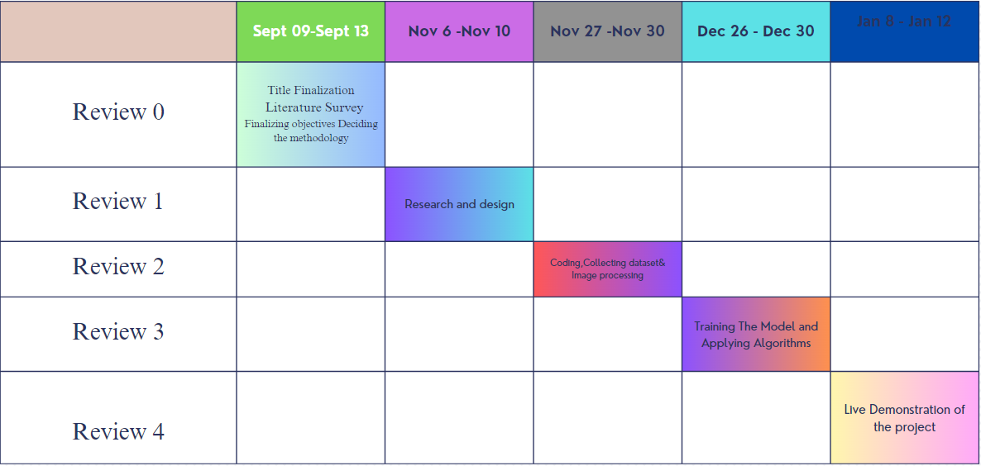
Timeline of the Project :

Slide 20
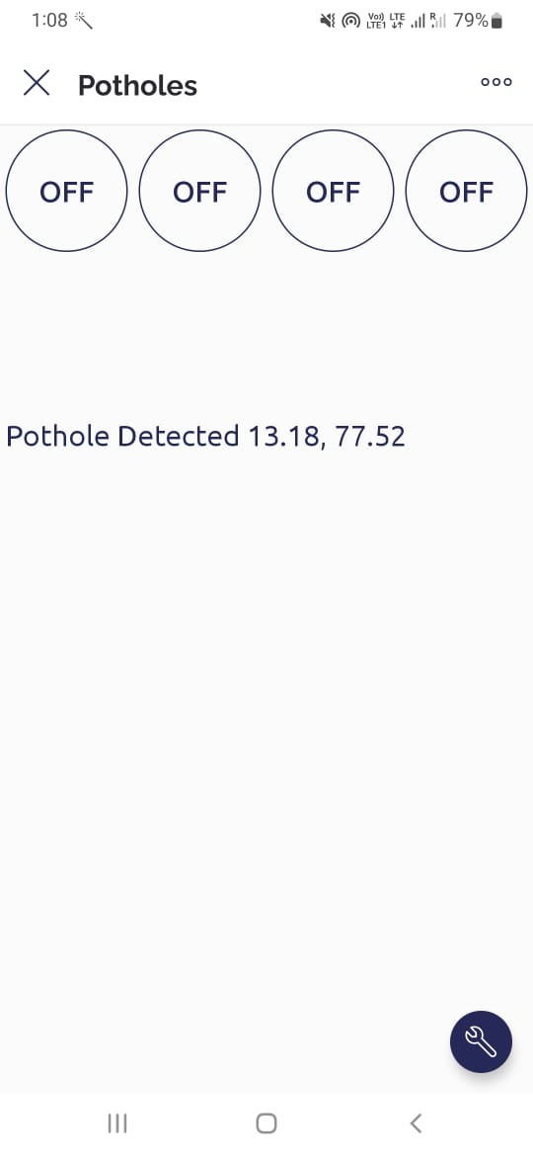
Outcomes

Slide 21
Expected Outcomes
Safer Travel : Users will experience safer journeys by receiving real-time alerts and warnings about road hazards, rainwater accumulation, potholes, and speed breakers. This will reduce the risk of accidents and damage to vehicles.
Efficient Travel : Travelers will benefit from more efficient route planning, leading to reduced travel times and lower fuel consumption. Optimized routes and traffic updates will contribute to smoother commutes.
User Engagement : The project will foster user engagement and participation, as users submit real-time reports and provide feedback on road conditions. This engagement will contribute to the system's continuous improvement.
User-Friendly Interface: The enhanced Google Maps features will be seamlessly integrated into the user interface, making them accessible and user-friendly for a broad range of travelers.
Public Awareness and Education: Travelers will become more aware of the availability and benefits of the enhanced features through public awareness campaigns. Educational materials will empower users to use the system effectively.

Slide 22
Conclusion
In conclusion, the automatic detection and notification system for potholes and humps on roads represents a significant advancement in road safety and driver assistance.
Through the integration of cutting-edge technologies such as computer vision and sensor networks, this system provides real-time information to drivers, enhancing their situational awareness and ultimately contributing to a safer driving experience.
By promptly identifying and notifying drivers about the presence of potholes and humps, the system minimizes the risk of accidents, vehicle damage, and discomfort for road users.
This proactive approach not only improves overall road safety but also reduces the economic burden associated with repairs and maintenance of vehicles caused by road irregularities.

Slide 23
Conclusion
The implementation of this system aligns with the broader goals of smart cities and intelligent transportation systems.
It fosters efficiency in traffic flow and promotes a seamless commuting experience by empowering drivers with crucial information about road conditions. Furthermore,
The data collected by the system can be utilized for strategic urban planning, aiding authorities in identifying areas requiring infrastructural improvements.
The environmental impact is also noteworthy, as the reduction in vehicular accidents and traffic congestion leads to decreased fuel consumption and emissions. This aligns with global efforts to create sustainable and eco-friendly transportation solutions.

Slide 24
References
[1] India Transport Sector. [Online]. Available: http://web.worldbank.org/WBSITE/EXTERNAL/COUNTRIES/SOUTHASIAEXT/EXTSARREGTOPTRANSPORT/0,,contentMDK:20703625~menuPK:868822~pagePK:34004173~piPK:34003707~theSitePK:579598,00.html
[2] Rajeshwari S., SanthoshHebbar, Varaprasad G., “Implementing Intelligent Traffic Control System for Congestion Control, Ambulance Clearance and Stolen Vehicle Detection”, IEEE Sensors Journal, Vol.15, No.2, pp.1109-1113, 2015
[3] Moazzam, K. Kamal, S. Mathavan, S. Usman, M. Rahman, “Metrology and Visualization of Potholes using the Microsoft Kinect Sensor”, In Proceedings of IEEE Conference on Intelligent Transport System, pp.1284-1291, 2013.
[4] Sudarshan S. Rode, Shonil Vijay, PrakharGoyal, PurushottamKulkarni, KaviArya, “Pothole Detection and Warning System”, In Proceedings of International Conference on Electronic Computer Technology, pp.286-290, 2009.

Slide 25
References
[5] He Youquan, Wang Jian, QiuHanxing, Zhang Wei, XieJianfang, “A Research of Pavement Potholes Detection Based on Three-Dimensional Project Transformation”, In Proceedings of International Congress on Image and Signal Processing, pp.1805-1808, 2011.
[6] Jin Lin, Yayu Liu, “Potholes Detection Based on SVM in the Pavement Distress Image”, In Proceedings of International Symposium on Distributed Computing and Applications to Business, Engineering and Science, pp.544-547,2010
[7] Faith Orhan, P. ErhanEren, “Road Hazard Detection and Sharing with Multimodal Sensor Analysis on Smartphones”, In Proceedings of International Conference on Next Generation Mobile Apps, Services and Technologies, pp. 56-61, 2013.
[8] ArtisMednis, Girts Strazdins, ReinholdsZviedris, GeorgijsKanonirs, Leo Selavo, “Real Time Pothole Detection using Android Smartphones with Accelerometers”, In Proceedings of Distributed Computing in Sensor Systems Workshop, pp.1-6, 2011.

Slide 26
References
[9] Zhen Zhang, Xiao Ai, C. K. Chan and NaimDahnoun, “An Efficient Algorithm for Pothole Detection using Stereo Vision”, In Proceedings of IEEE Conference on Acoustic, Speech and Signal Processing, pp.564-568, 2014.
[10] MirceaStrutu, GrigoreStamatescu, Dan Popescu, “A Mobile Sensor Network Based Road Surface Monitoring System”, In Proceedings of IEEE Conference on System Theory, Control and Computing, pp.630–634, 2013.
[11] SachinBharadwaj, Sundra Murthy, GollaVaraprasad “Detection of potholes in autonomous vehicle”, IET Intelligent Transport Systems, Vol.8, No.6, pp.543-549, 2013.

Slide 27

Acceptance Certification :

Slide 28
Thank You

